Slide 1







Verification of SPI slave IP with systemVerilog
CND 212 : Digital Testing and Verification

Slide 2
Team Members
Student Name | ID
Ahmed mohamed mohamed shawky Elattar | V23010568
Muhammed Khaled Omar Orabi | V23010695
Mohammed Salah Aboshosha Mohammed | V23010141
Omar Dyaa Mohammed Mohamed | V23010501
Amr mohamed ali hassan | V23010177

Slide 3
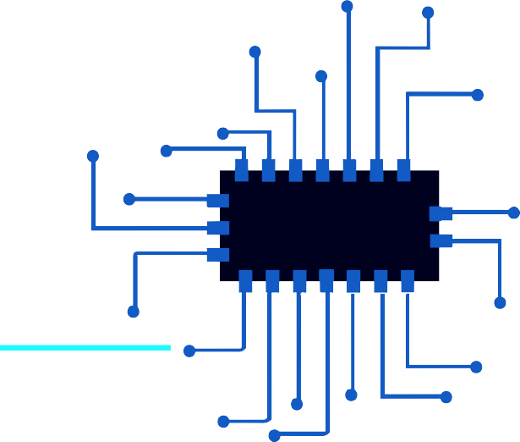
Content
Wave form
code
Coverage
Project
description
Eda tools
Test bench

Slide 4
Project Description
In this project, we will test an SPI slave IP using systemVerilog. This will involve using an actual IP or an abstract model as the test will assume a black box approach. The testing will be incorporating new features offered by SystemVerilog such as interfaces, classes, constrained-random stimulus generation, and coverage-driven verification methodologies. You will be required to show different test scenarios for the Slave IP showing modularity and reusability of the test environment.

Slide 5
Project Description
Testing an SPI slave IP using SystemVerilog is a comprehensive task that involves various advanced features of the language. Here’s a high-level overview of how you might approach creating different test scenarios:
1- Define the Interface: Use SystemVerilog interfaces to encapsulate the signals related to the SPI protocol (like mosi, miso, sclk, and ss).
2- Create the Testbench: Develop a testbench that instantiates the SPI interface, the DUT (Device Under Test), and the test environment.
3- Develop the Test Environment: Build a test environment with classes that represent different components like drivers, monitors, and scoreboards.
4- Generate Stimulus: Use constrained-random stimulus generation to create a variety of valid and invalid scenarios.
5- Implement Coverage: Define coverage points to ensure that all interesting scenarios are being tested.
6- Create Scenarios: Write scenarios that test the SPI slave IP under different conditions, such as varying clock speeds, data patterns, and error conditions.
7- Modularity and Reusability: Ensure that your test components are modular and reusable. For example, you can create a generic SPI driver that can be used with different types of SPI devices.
8- Run the Tests: Execute the tests and analyze the results. Use the coverage data to identify any scenarios that have not been tested.
9- Iterate: Refine the test scenarios based on the results and coverage data to improve the test environment and achieve better verification.

Slide 6









EDA Tools
eda playground
(synopsys VCS 2023.03)
vcs
dve
verdi

Slide 7
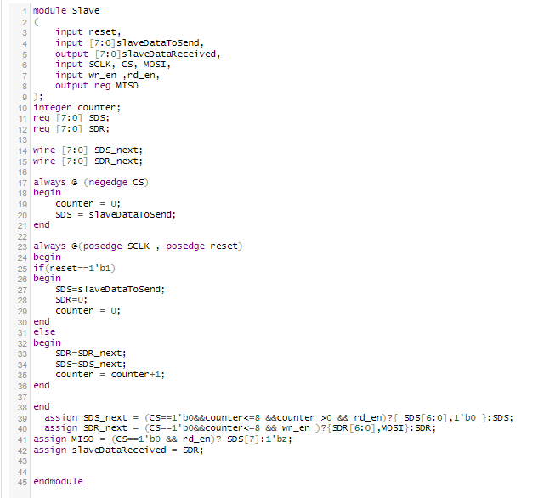
module Slave

Slide 8
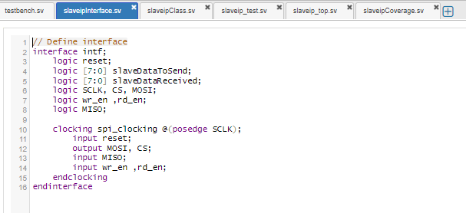
Slave ip interface

Slide 9
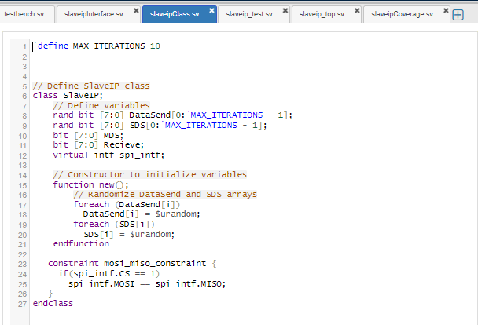
Slave ip class

Slide 10
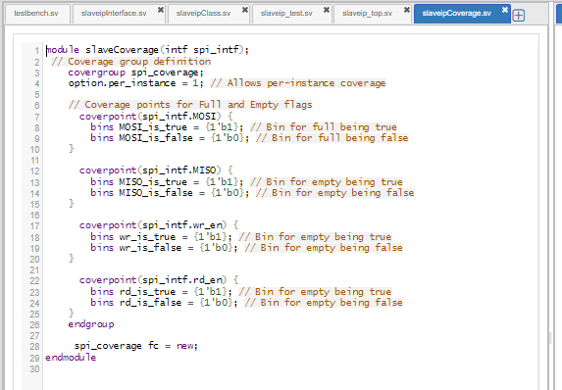
slaveCoverage(intfspi_intf)

Slide 11
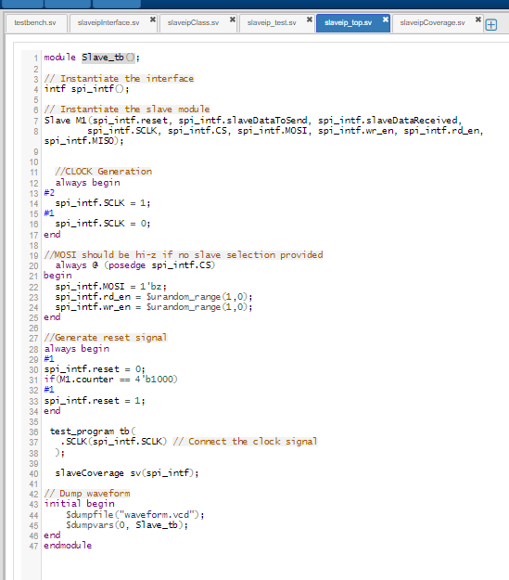
Slave_tb()

Slide 12
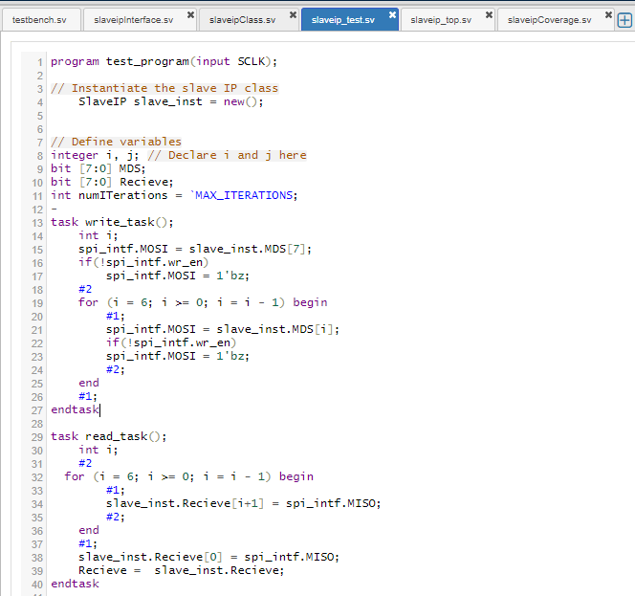
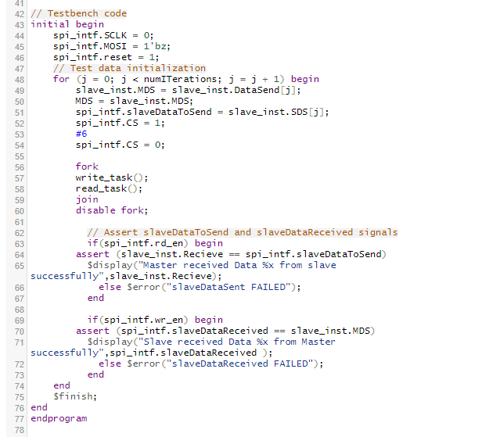
test_program

Slide 13

Eda playgrounglink
https://www.edaplayground.com/x/iZZg

Slide 14
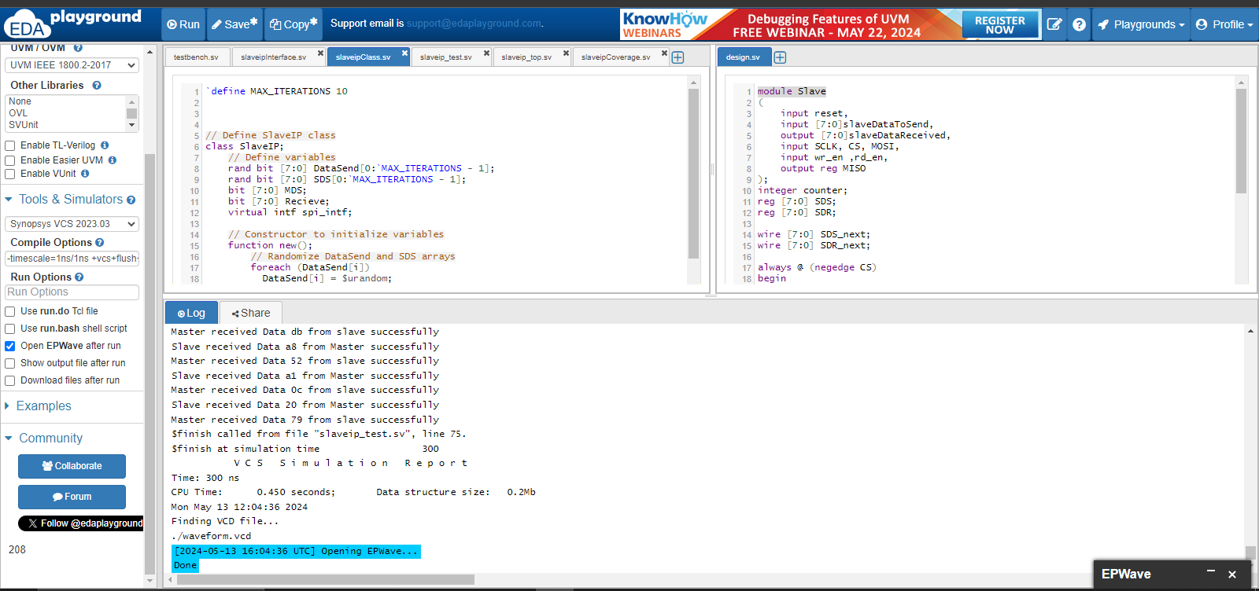
Eda run result

Slide 15
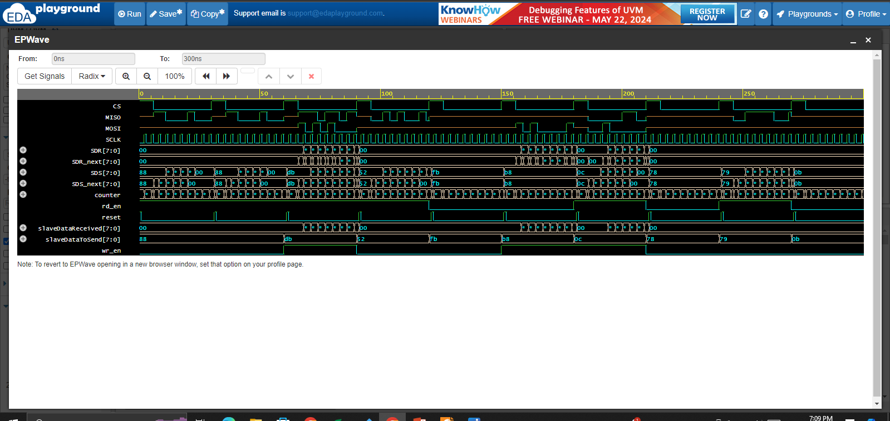
Eda ep wave

Slide 16
Cmd commands
vcs -sverilog -ntb_opts dtm -cm line+cond+fsm+tgl Slaveip_Top.sv Slaveip-RTLdesign.v Slaveip_Test.sv Slaveip_Interface.sv Slaveip_Class.sv Slaveip_Coverage.sv
./simv -cm line+cond+fsm+tgl
urg -dir simv.vdb
Verdi –cov –covdir simv.vdb &

Slide 17
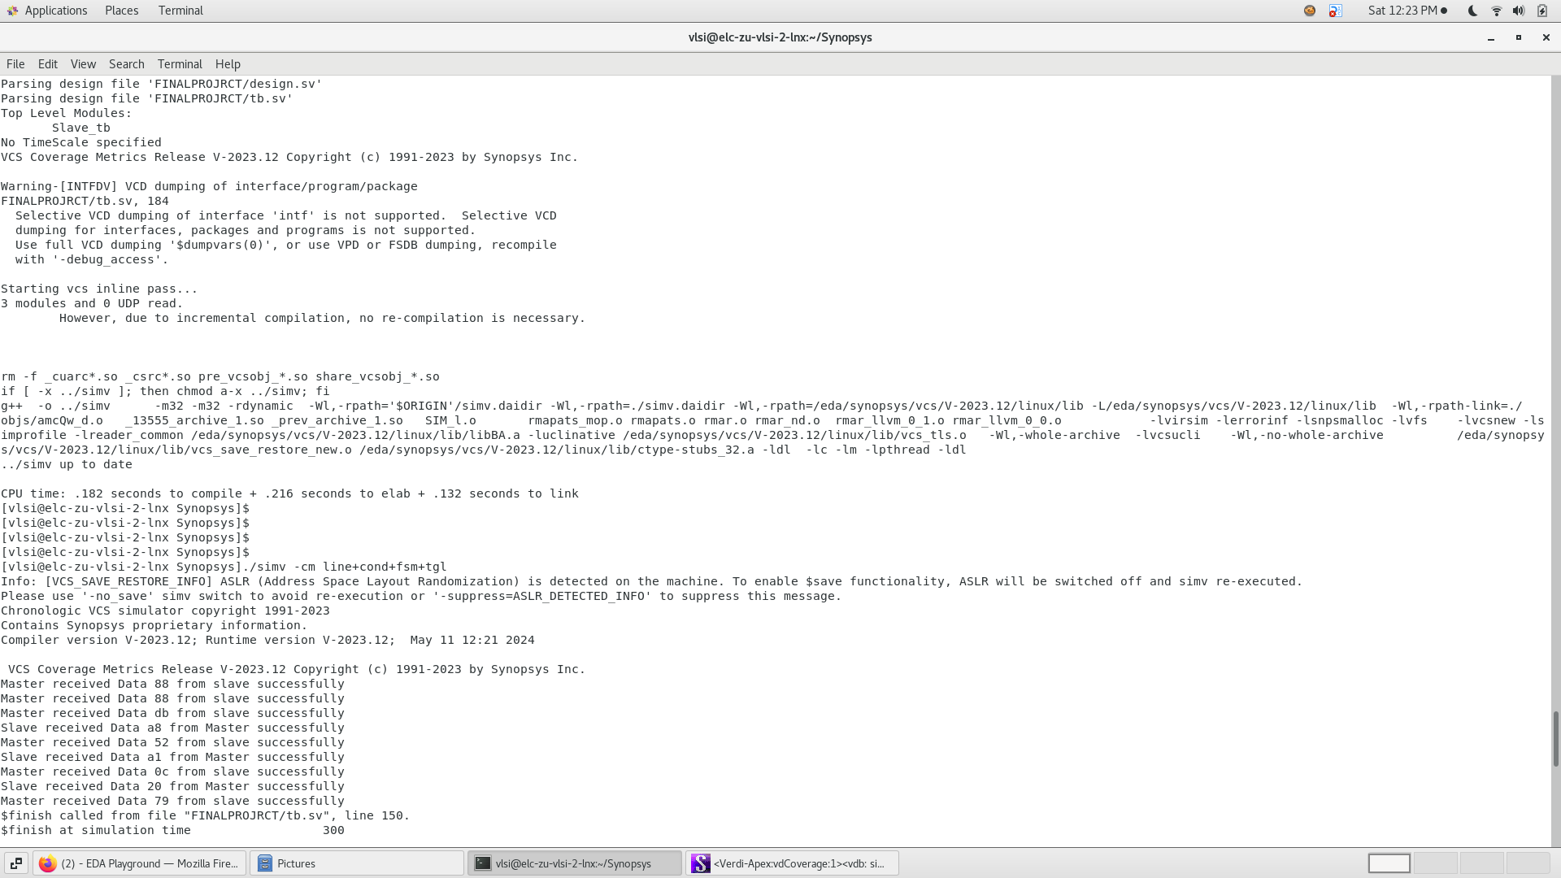
Vcs result

Slide 18
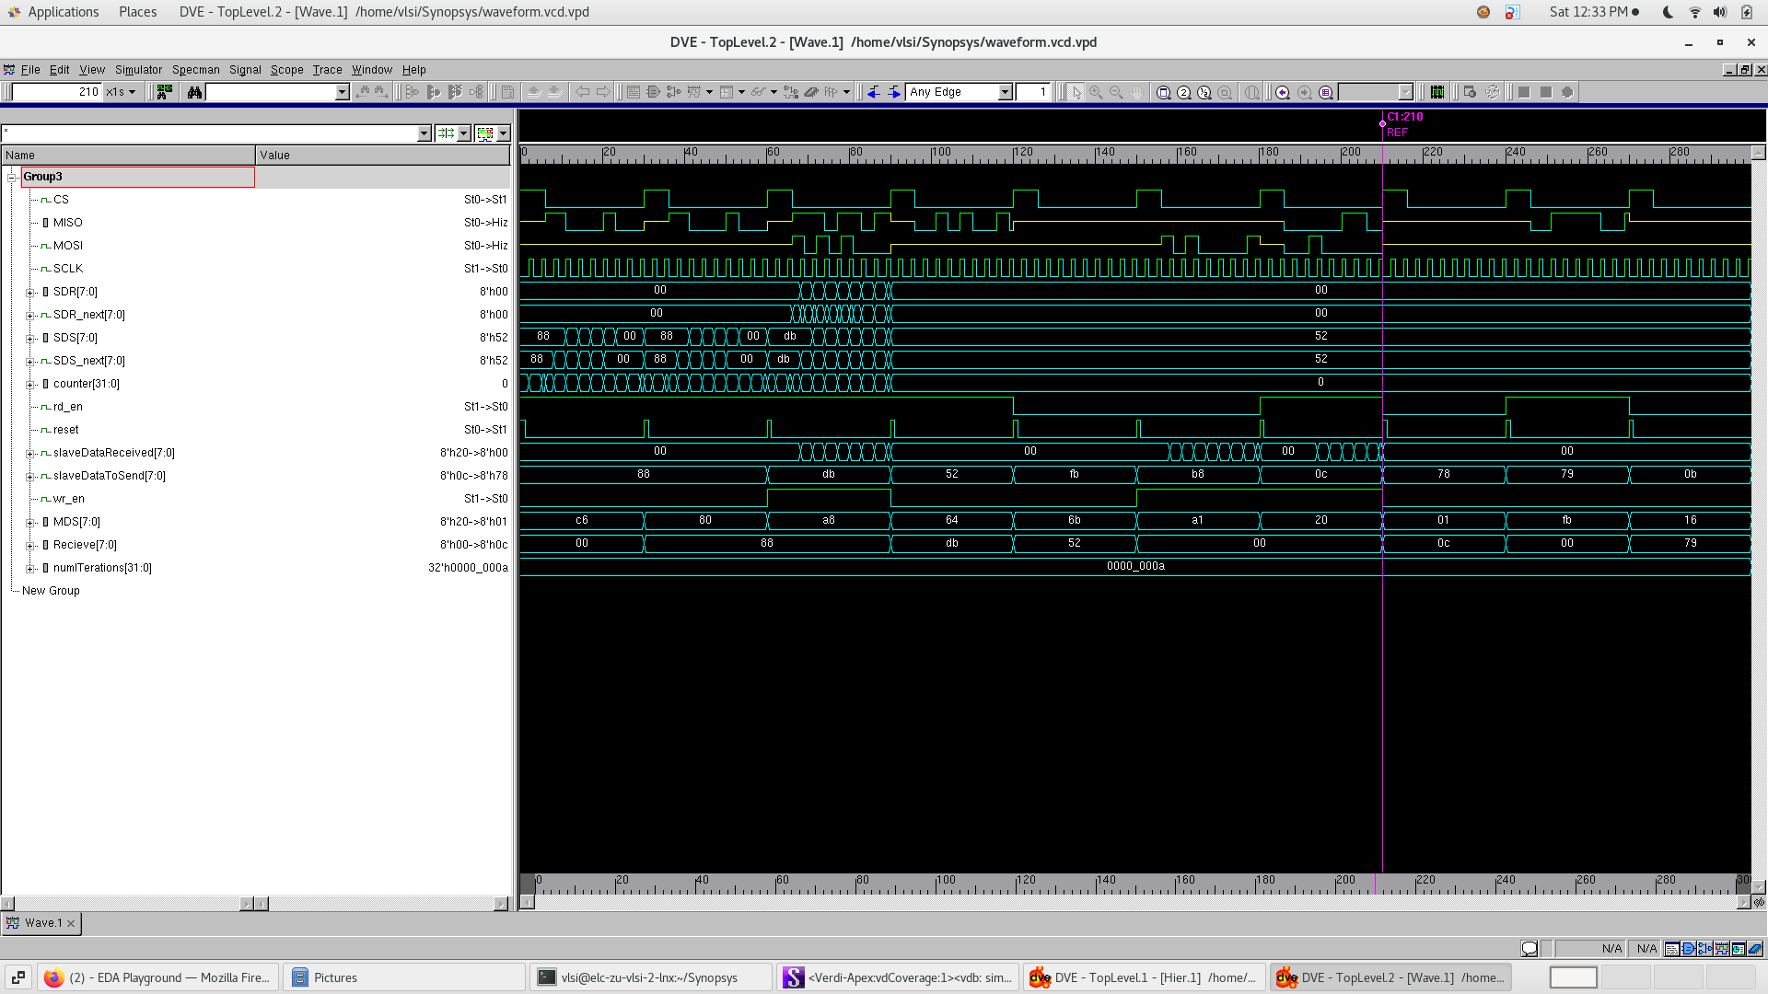
Dve wave form

Slide 19
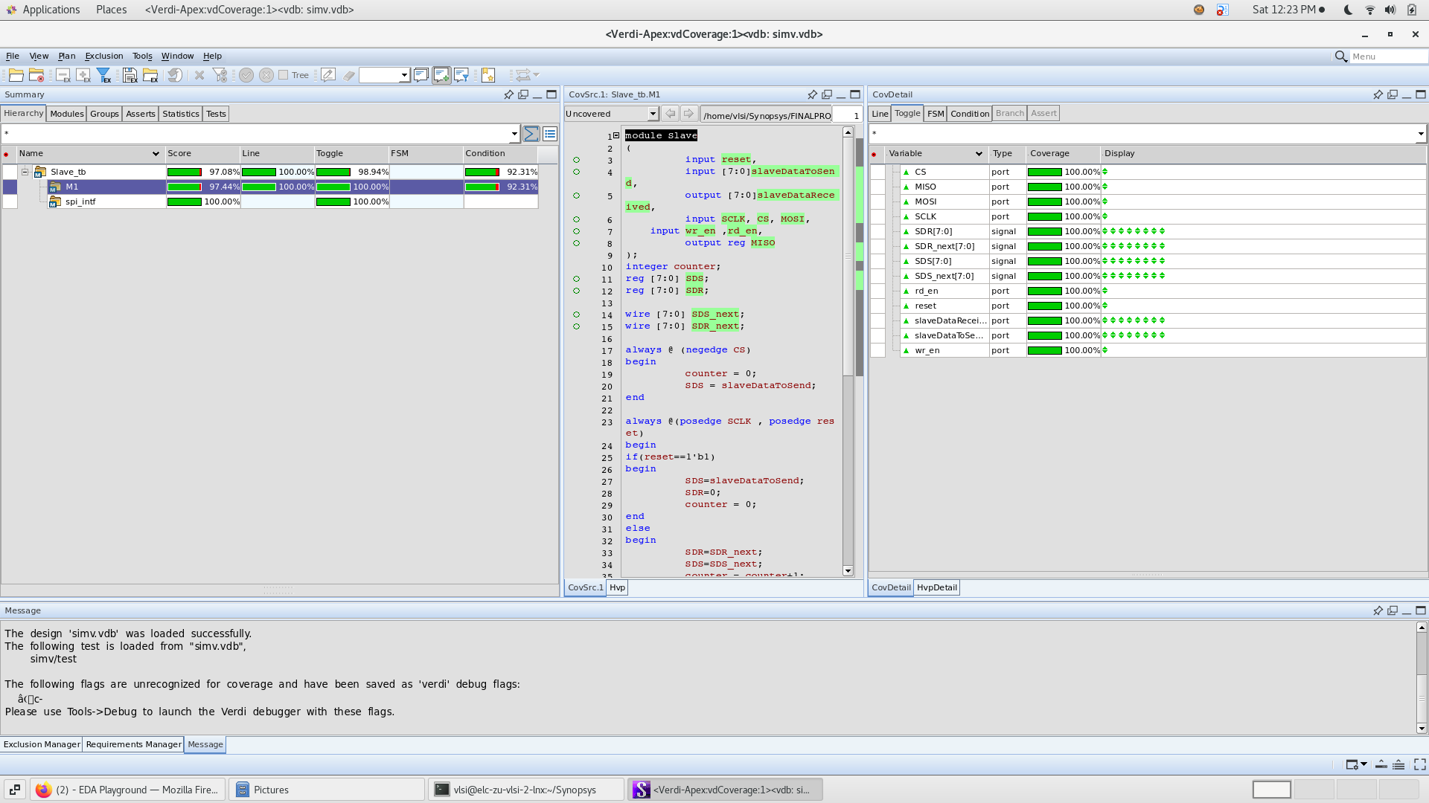
Verdi coverage

Slide 20

For more information, click on the GetHub link or Scan the QR
https://github.com/tito642/Verification-of-SPI-slave-IP-with-systemVerilog

Slide 21

THANKs

